Slide 1

Paper Review
A Osamu Katagiri Tanaka A01212611@itesm.mx
09 Dec 2019

Slide 2
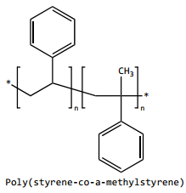
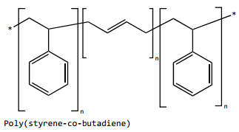
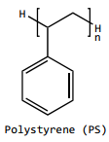
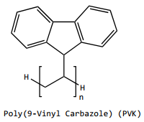
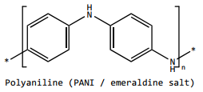
● FFES
● NFES
Polyaniline (PANI)
Good electrical conductivity
and environmental stability for biomedical and technological applications
However, the poor solubility of PANI in common solvents and low molecular weight interferes with electrospinning into uniform fibers
Sironi, A., Marinotto, D., Riccardi, C., Zanini, S., Guerrini, E., Della Pina, C., & Falletta, E. (2015). Effect of salicylic acid and 5-sulfosalicylic acid on UV-Vis spectroscopic characteristics, morphology, and contact angles of spin coated polyaniline and
poly(4-aminodiphenylaniline) thin films. Journal of Spectroscopy, 2015. https://doi.org/10.1155/2015/609175

Slide 3
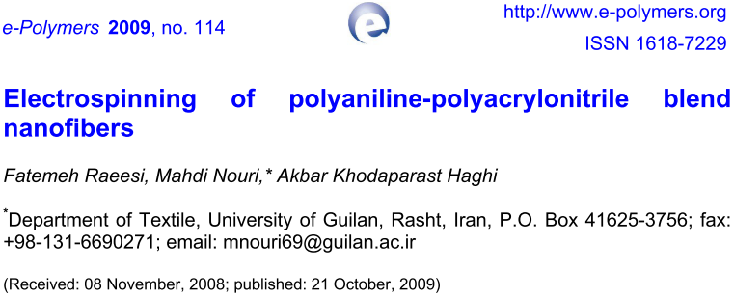
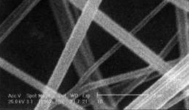
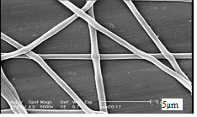
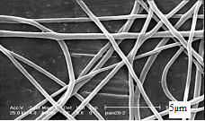
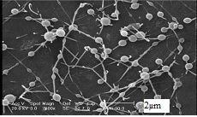
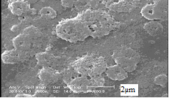
Previous Work (2009) …
Typically, the use of an insulating copolymer with high molecular weight is expected to act as a remedy
However, the presence of a nonconducting polymer modifies the properties of PANI
100% PAN
Fiber diam: 652nm
10% PANI w/PAN
Fiber diam: 602nm
20% PANI w/PAN
Fiber diam: 425nm
30% PANI w/PAN
Fiber diam: 164nm
100% PANI
Fiber diam: <NA>
Raeesi, F., Nouri, M., & Haghi, A. K. (2009). Electrospinning of polyaniline-polyacrylonitrile blend nanofibers. E-Polymers, (October). https://doi.org/10.1515/epoly.2009.9.1.1350
Sironi, A., Marinotto, D., Riccardi, C., Zanini, S., Guerrini, E., Della Pina, C., & Falletta, E. (2015). Effect of salicylic acid and 5-sulfosalicylic acid on UV-Vis spectroscopic characteristics, morphology, and contact angles of spin coated polyaniline and poly(4-aminodiphenylaniline) thin films. Journal of Spectroscopy, 2015. https://doi.org/10.1155/2015/609175

Slide 4
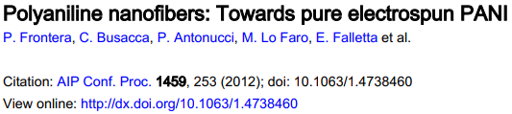
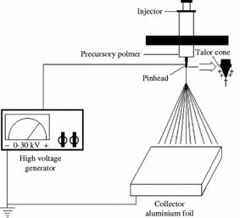
The Paper (2012) …
“In this work we report the preparation of highly pure polyaniline fibers by electrospinning process.”
“Here we report a route to prepare PANI fibres reducing the PEO amount from 1 to 0% w/w with respect to the amount of PANI.”
Frontera, P., Busacca, C., Antonucci, P., Faro, M. Lo, Falletta, E., Pina, C. Della, & Rossi, M. (2012). Polyaniline nanofibers: Towards pure electrospun PANI. AIP Conference Proceedings, 1459(1), 253–255. https://doi.org/10.1063/1.4738460

Slide 5
FFES - Process Parameters
Polymer precursor: PANI doped with Dodecyl Benzene Sulfonic Acid to produce PANI-DBSA
Solvent: Chloroform with different PEO to PANI-DBSA concentrations
Deposition temperature: 21 °C
Deposition rate: 707 μl/h
Needle-to-collector distance: 12 cm
Electrospinning variation: rotating drum as collector

Slide 6
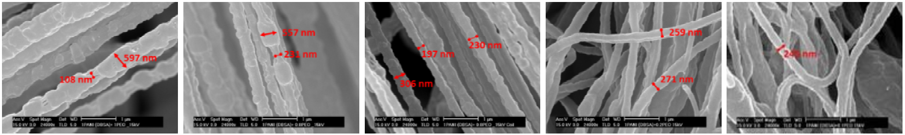
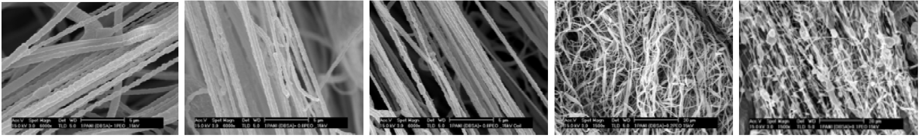
high magnification
low magnification
PANI:PEO 1:1 w/w
Fiber diam: 597nm
PANI:PEO 1:0.8 w/w
Fiber diam: 306nm
PANI:PEO 1:0.2 w/w
Fiber diam: 259nm
PANI:PEO 1:0.1 w/w
Fiber diam: 240
Frontera, P., Busacca, C., Antonucci, P., Faro, M. Lo, Falletta, E., Pina, C. Della, & Rossi, M. (2012). Polyaniline nanofibers: Towards pure electrospun PANI. AIP Conference Proceedings, 1459(1), 253–255. https://doi.org/10.1063/1.4738460

Slide 7

Q&A

Slide 8
References
Cárdenas, B. (2017). Advanced Manufacturing Techniques for the Fabrication and Surface Modification of Carbon Nanowires, 160.
Flores, D. R. (2017). Role of rheological properties in near field electrospun fibers morphology, 130.

Slide 9
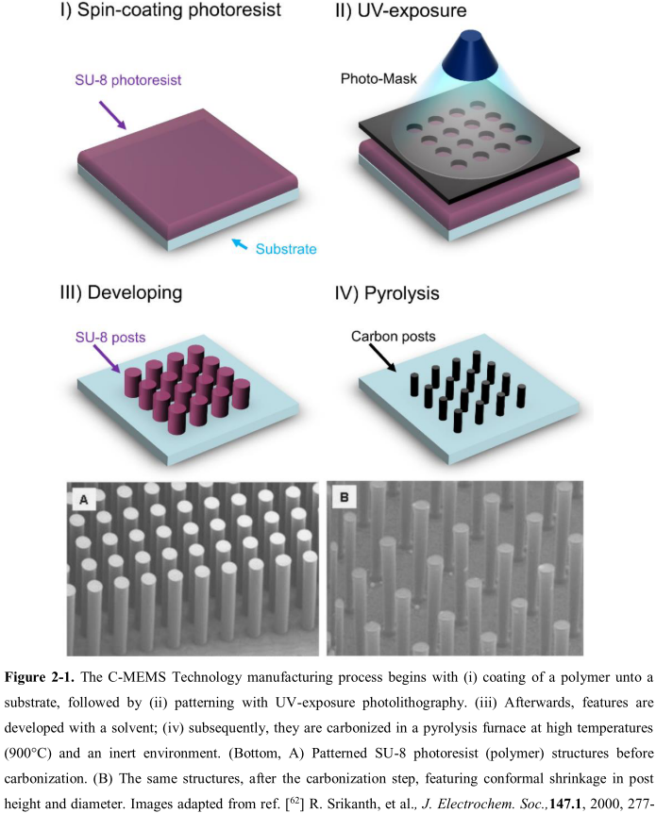
Previous work
The production of C-MEMS:
Polymer patterning through photolithography electrospinning
Carbonization through pyrolysis
SU-8 waste

Slide 10
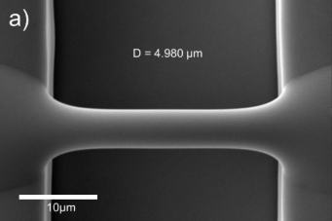
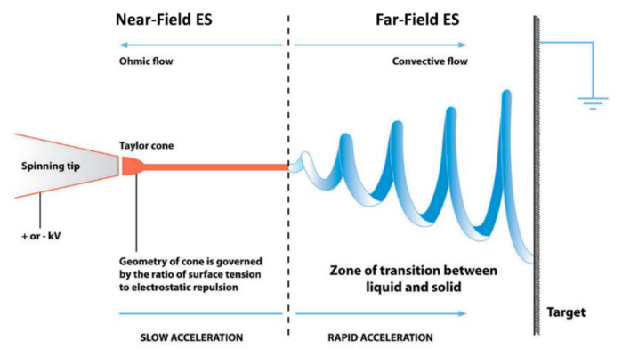
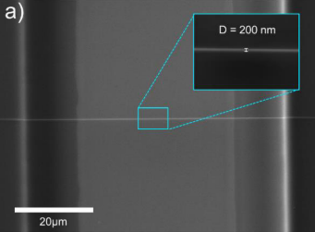
Best Results so far by Braulio & Ricardo
Fiber yield rate of 81 %
Fiber diameter before pyrolisis of 4.966 μm
Fiber diameter after pyrolisis of 204 nm
Fiber length of 60.5 ± 4.3 μm
Fiber resistance from 407 KΩ to 1.727 MΩ

Slide 11
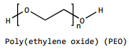
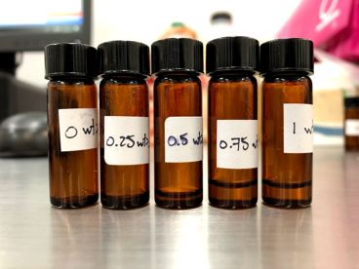
Polymer Solutions
wt% PEO 0.25 | SU-8 2002 [mg] | PEO [mg] | TBT [mg]
 | 2246 | 5.65 | 11.32
= 2 ml of solution
With zero shear viscosity of 0.88 Pa.s electrospun at 600V (solution used to get the results of the previous slide)
Next step -> Discover a new polymer solution to beat Braulio’s record …
Notes:
Surface t-

Slide 12
wt% PEO Solution
The EMS polymer solution consisted of
2ml of SU-8 2002 mixed with
0.5 wt% of Poly(ethylene oxide) (PEO, 4,000,000 MW; SigmaAldrich Inc., Cat. N. 189464) and
0.5 wt% Tetrabutylammonium Tetrafluoroborate salts (TBATFB; SigmaAldrich Inc., Cat. N. 217964) to increase its conductivity and allow smooth polymer flow during electrospinning.
All reagents were used as received. Magnetic stirring of these components was performed for 1hr at 75°C and low rpm (100-150 rpm).

Slide 13
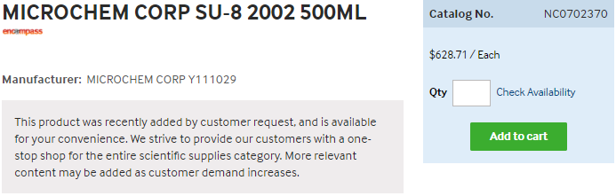
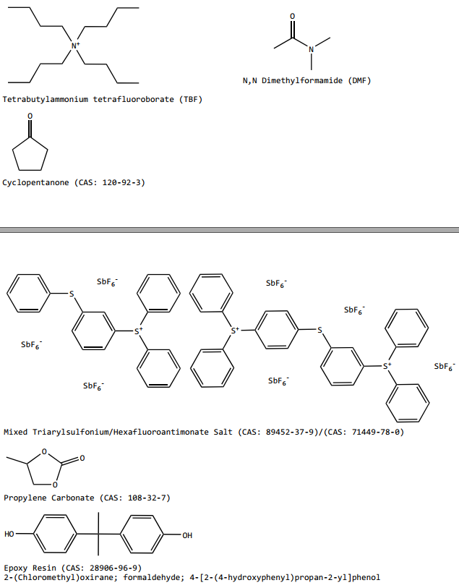
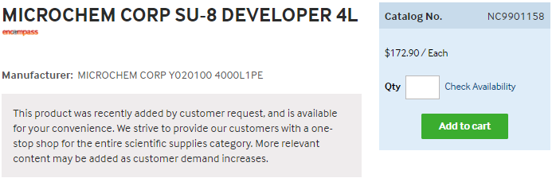
https://www.fishersci.com/shop/products/NC0702370/nc0702370#?keyword=MICROCHEM+CORP+PHOTORESIST+SU-8
https://www.fishersci.com/shop/products/NC9901158/nc9901158#?keyword=SU-8++developer

Slide 14
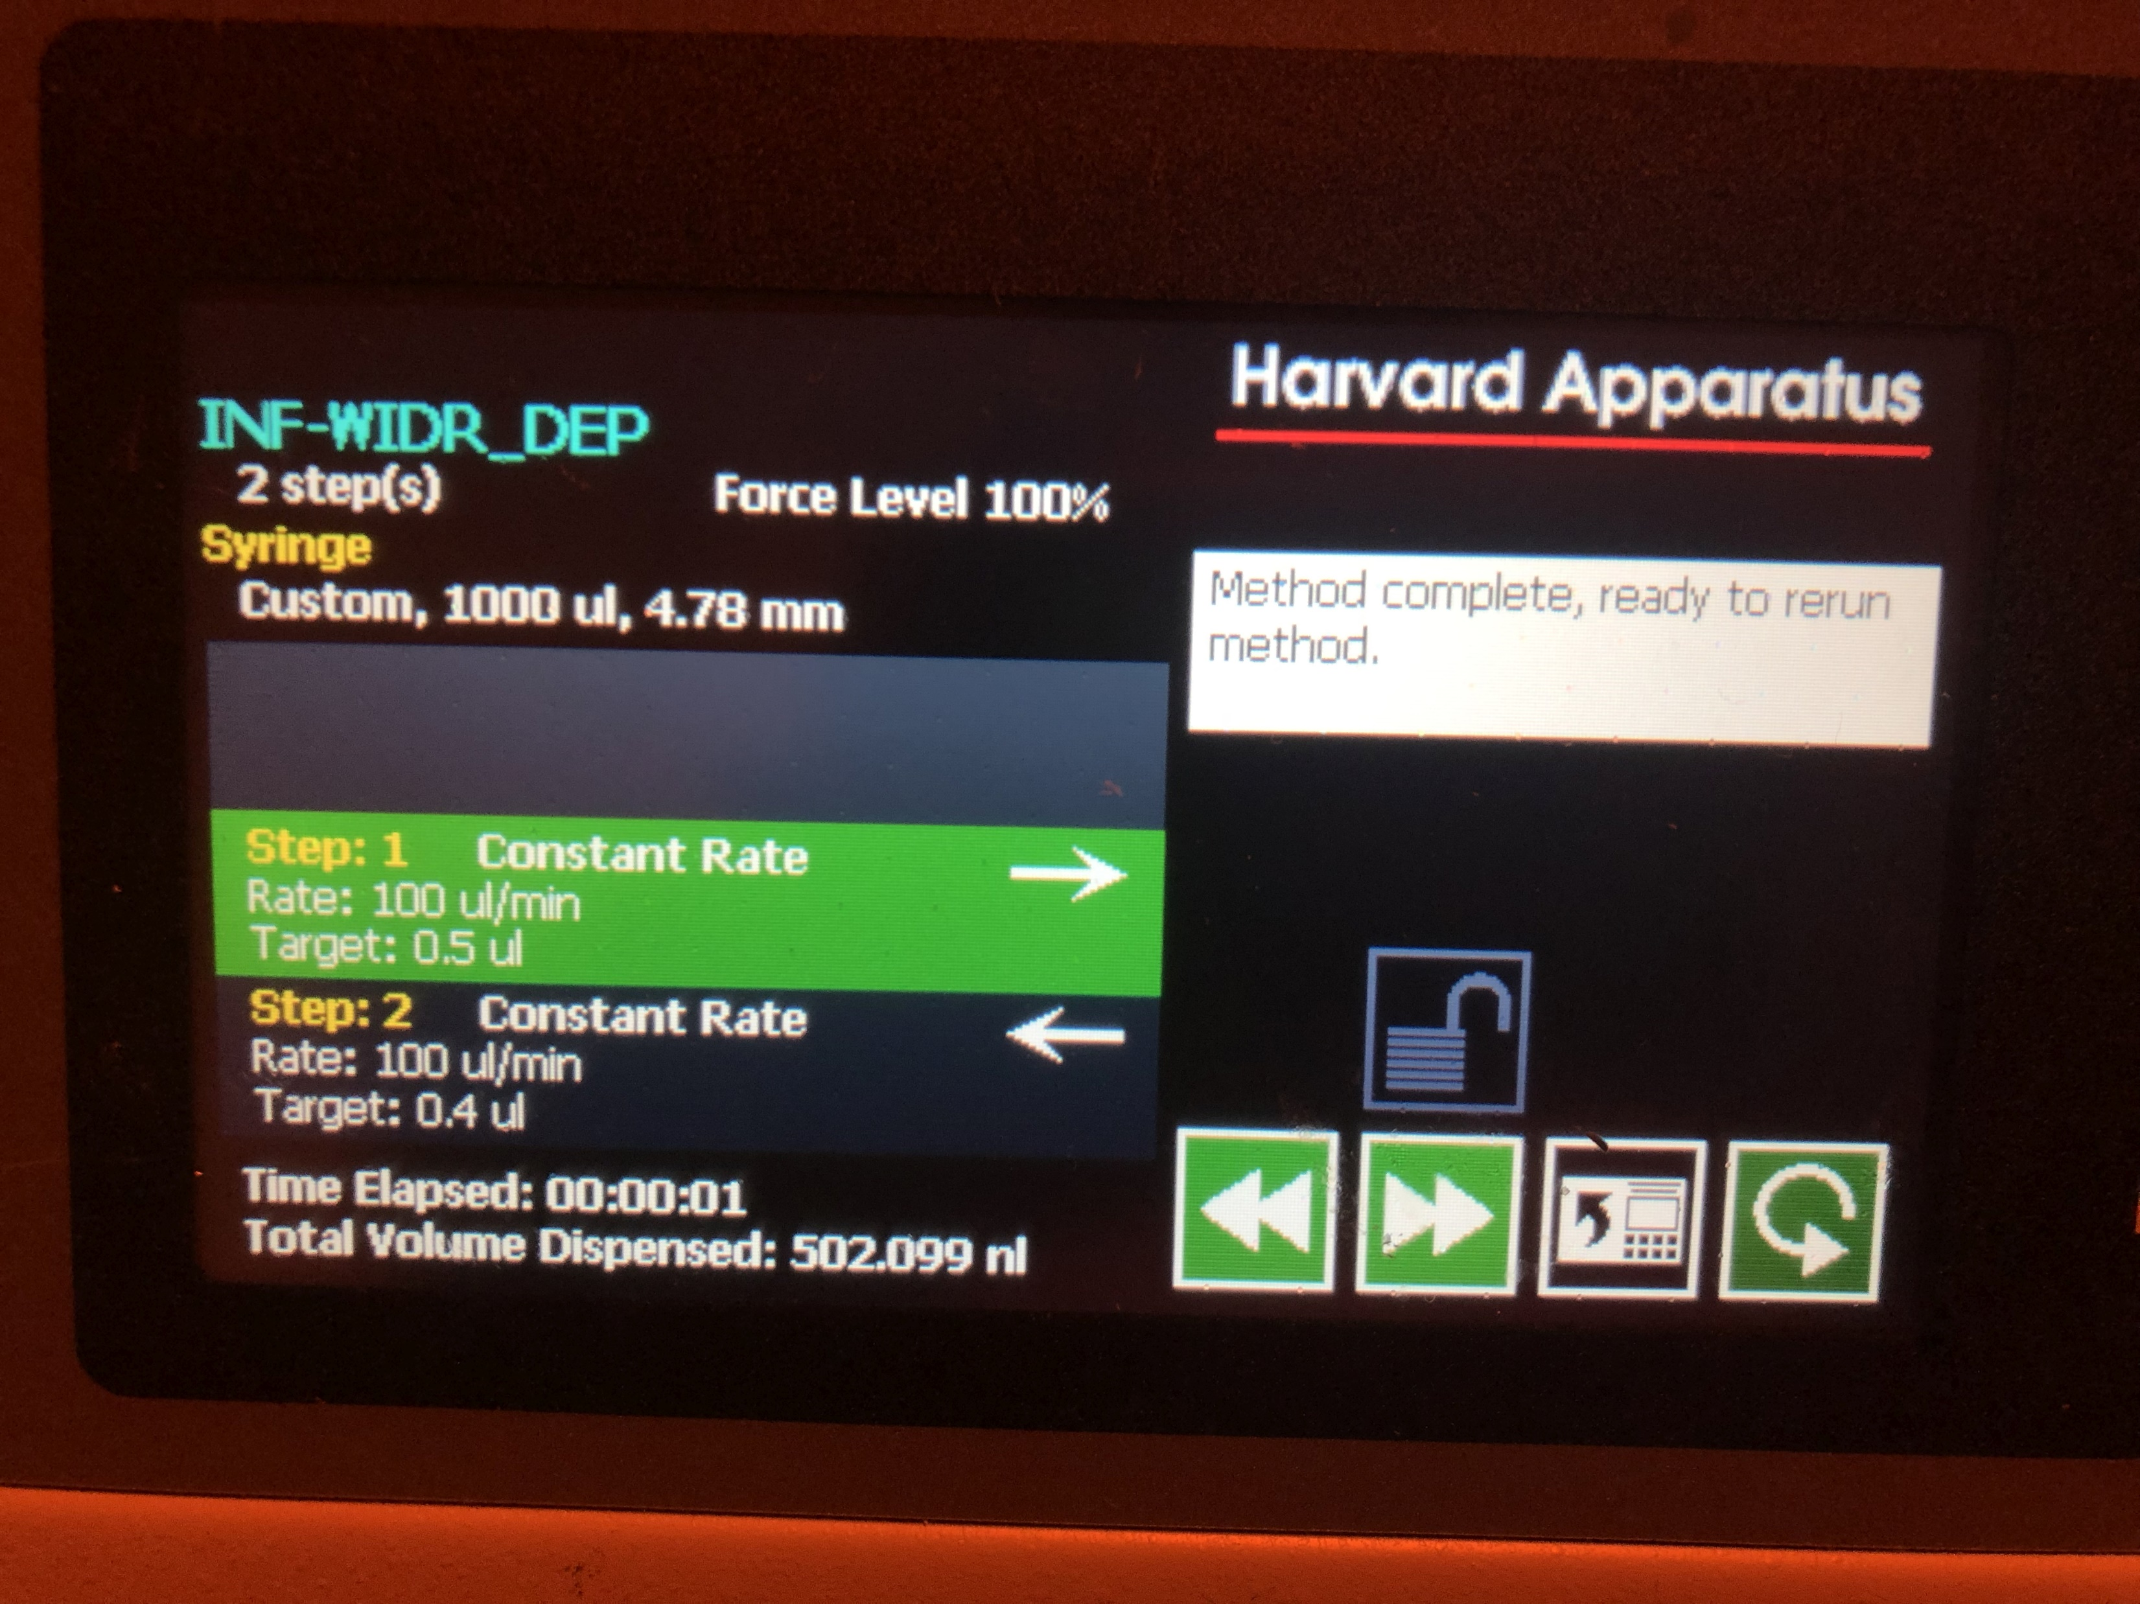
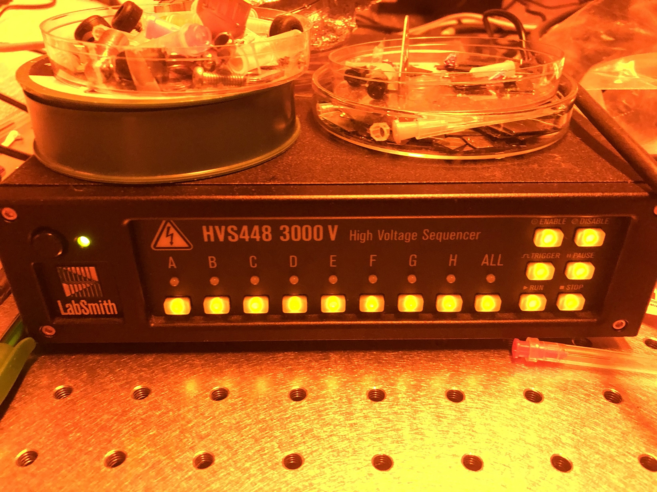
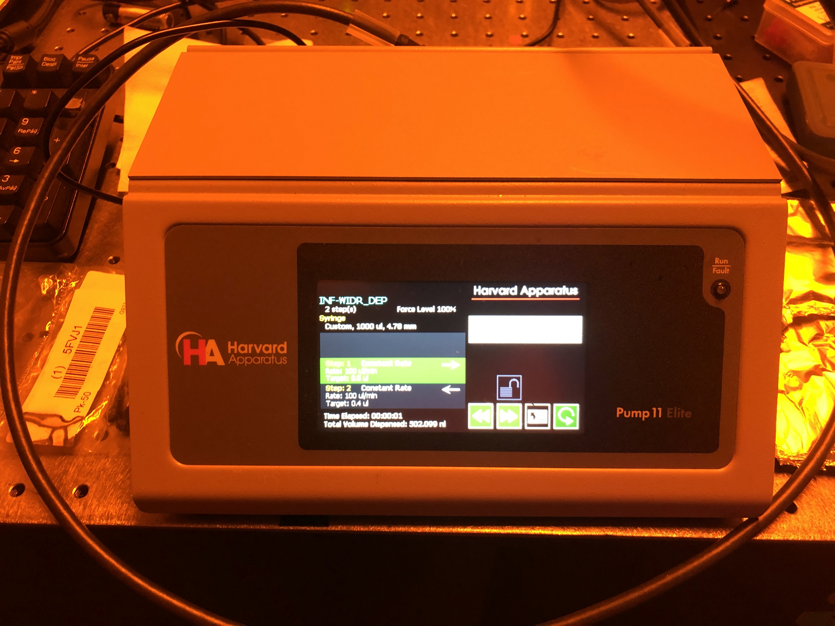

Slide 15
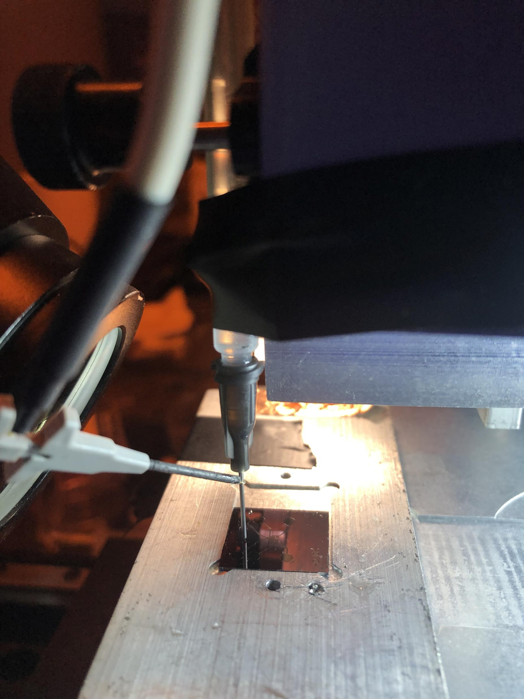
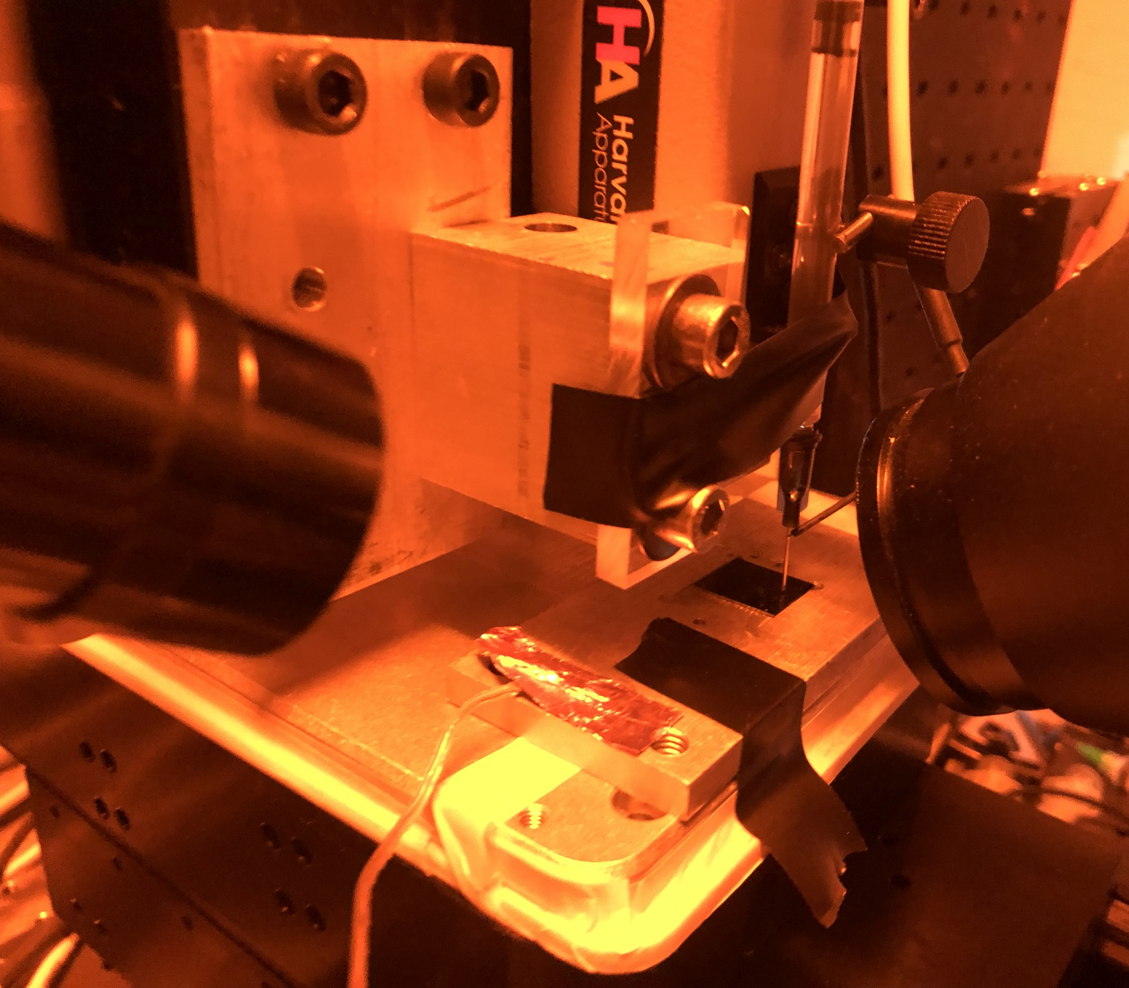

Slide 16
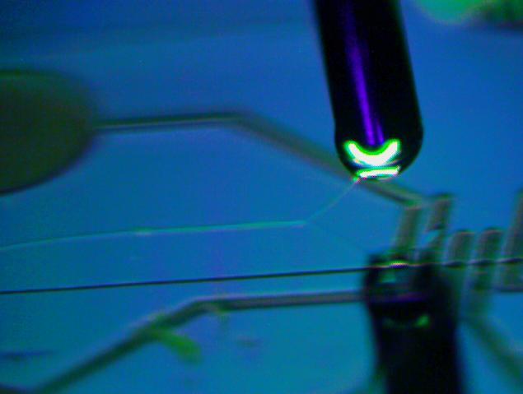
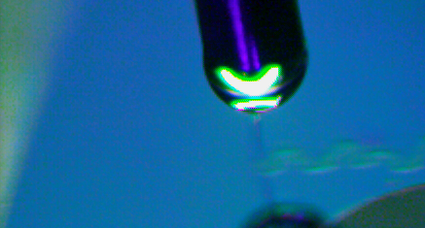
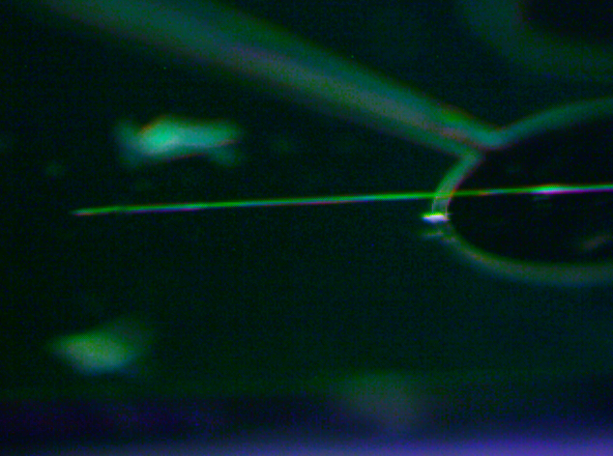
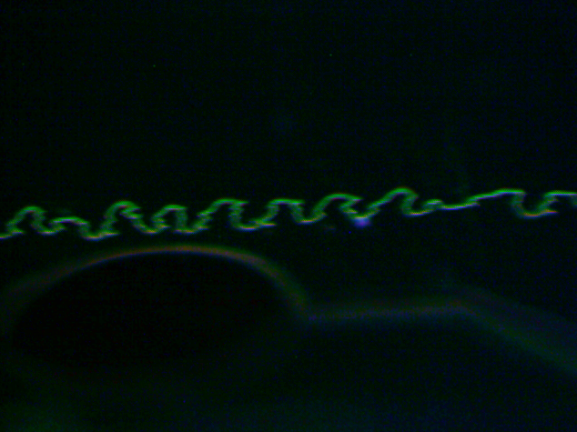
600 V
700 V

Slide 17
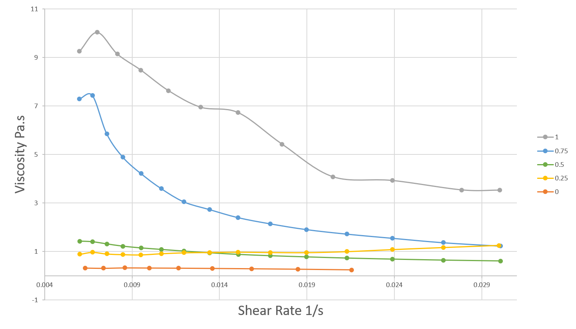

Slide 18
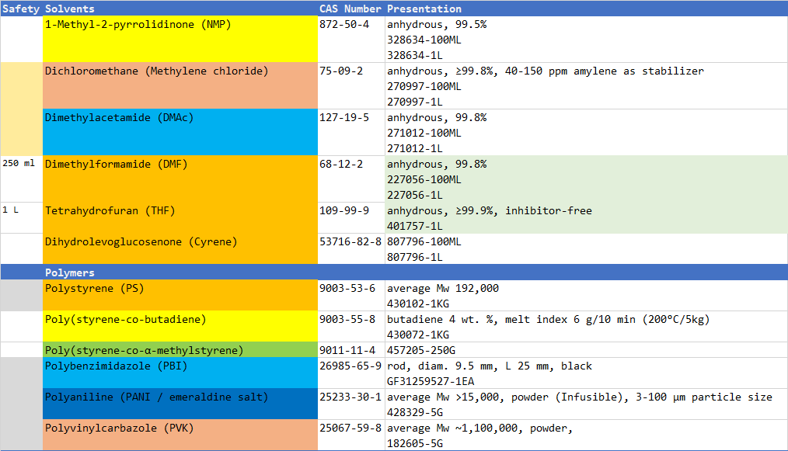

Slide 19
<subTitle>
<content> <key concept>

